Slide 1
Visual intelligence Course project
Nicolò Squarzoni
Verona, 05/05/2023

Slide 2
Project motivation
The scope of this project was to classify a dataset of images divided in two classes through a Convolutional Neural Network and through a Multilayer Perceptron fed with the features generated by the Scattering transform of the input images, eventually comparing their classification performances.

Slide 3
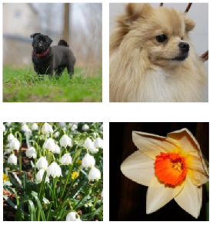
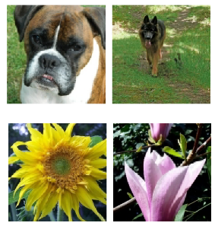
Project set up: Technical choices
It has been chosen a dataset of 128 x 128 pixel colored images divided in two classes, flowers and dogs, and each class features a training subset of 1200 images and a test subset of 400 images.
Since the neural network training requires a consistent computational capacity and a consistent amount of time, Google Colab has resulted a great option, due to the possibility to access for free GPUs and upload the dataset on Google Drive.
According to the project requirements, the framework used to create and manage the neural networks is Pytorch.

Slide 4
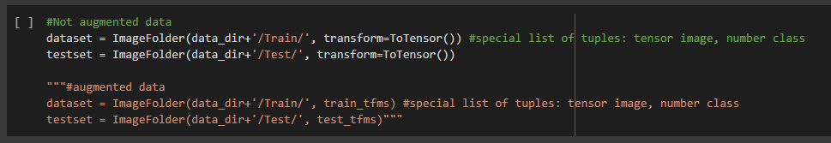
Project set up: Dataset Processing
The first implementation step has been the creation of a specific data structure from the image dataset to feed the neural network for training, validation and testing.

Slide 5
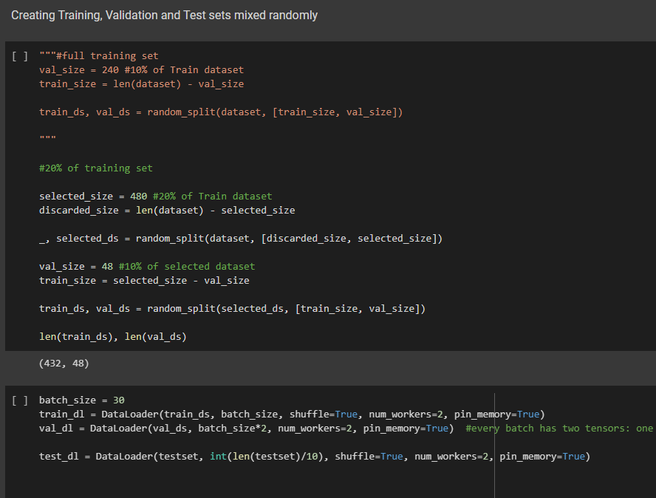
Project set up: Dataset Processing
The first implementation step has been the creation of a specific data structure from the image dataset to feed the neural network for training, validation and testing.

Slide 6
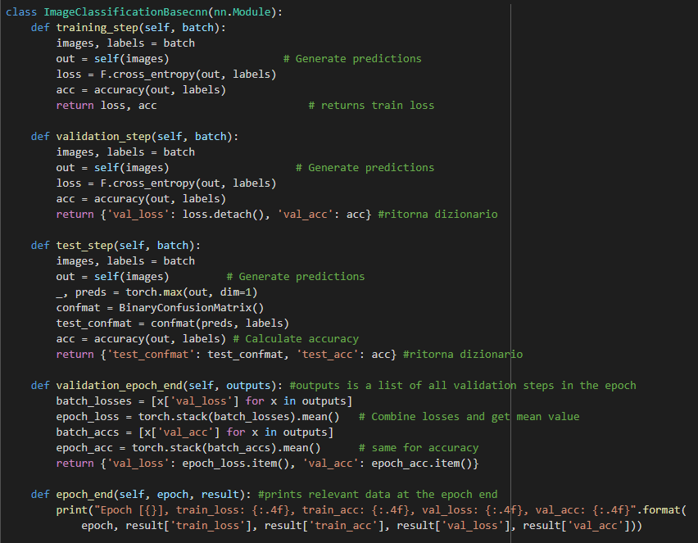

Project set up: Models definition
It has first been created a class inheriting from the base class nn.Module, available from Pytorch library for the purpose of building neural networks.
MLP + Scattering version

Slide 7
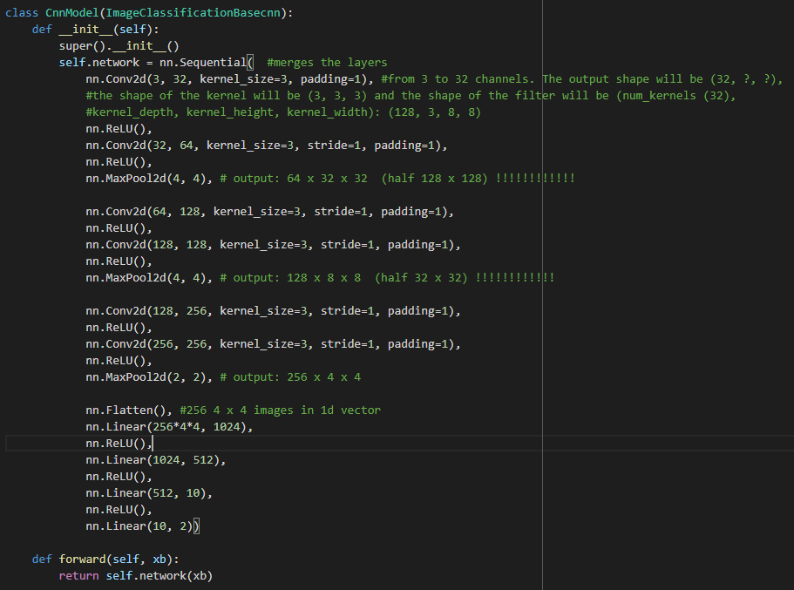
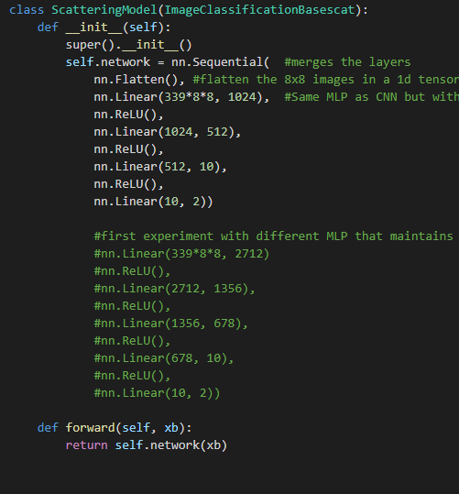
Project set up: Models definition
The CNN class model inherits all the methods from ‘’ImageClassificationBasecnn’’ and the other model from ‘’ImageClassificationBasescat’’

Slide 8
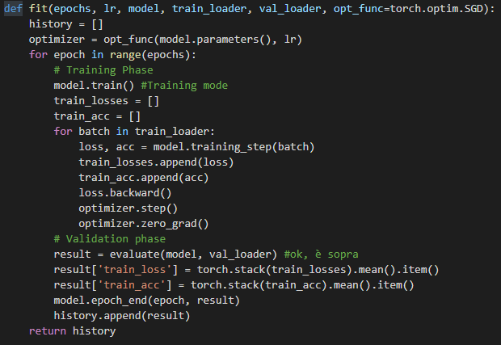
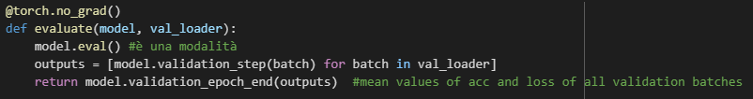
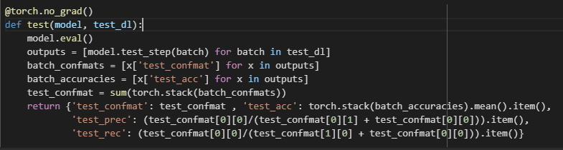
Project set up: Training, validation and testing
After defining the models, the training, validation and testing functions have been created

Slide 9
Project set up: further useful functions
Save and retrive trained models
Save and retrive training log with loss and accuracy
Plot training and validation loss and accuracy during training
Plot CNN filters in coloured images and in gray scale
Plot Scattering transform filters

Slide 10
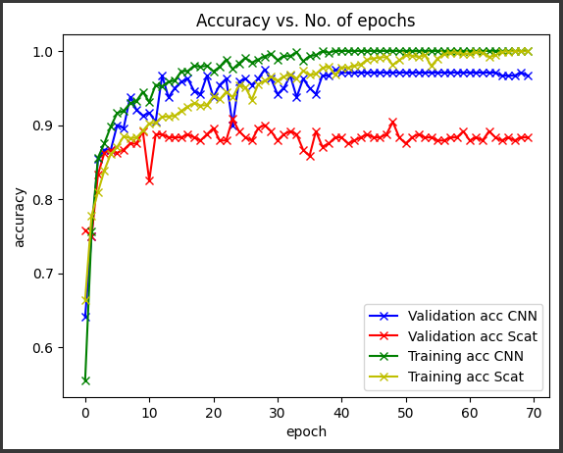
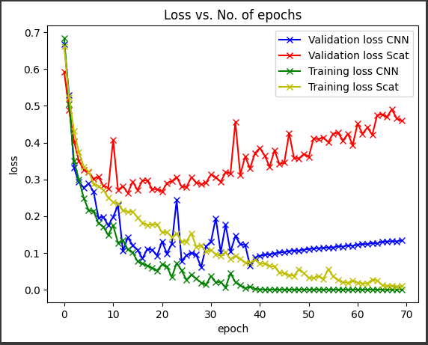
testing: CNN vs Scattering + MLP on full dataset
For both models the first tentative training has been performed setting 70 training epochs, a learning rate of 0,0001, and Adam algorithm as optimizer.
Overfitting!

Slide 11
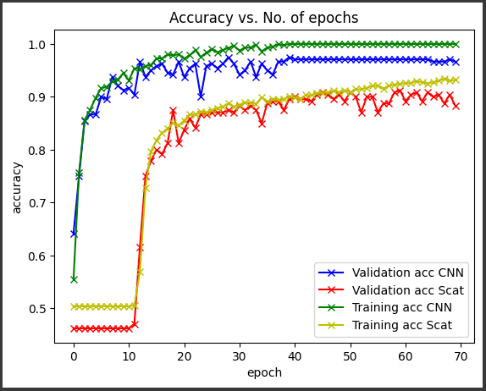
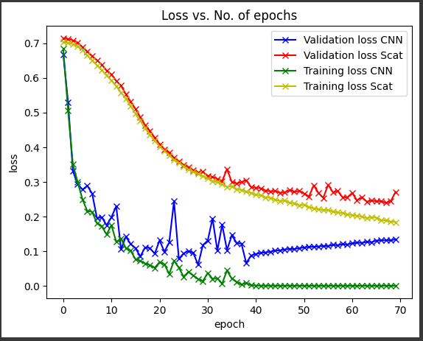
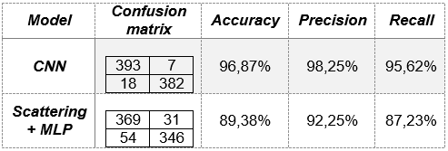
testing: CNN vs Scattering + MLP on full dataset
To eliminate the overfitting it has been chosen repeat the training with a learning rate of 0,00001.

Slide 12
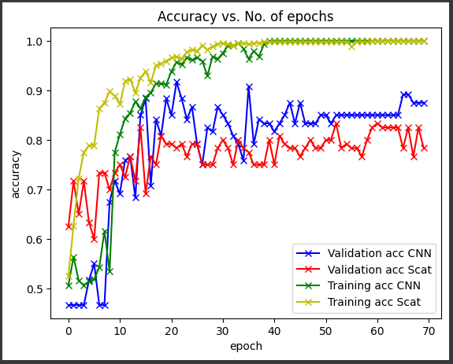
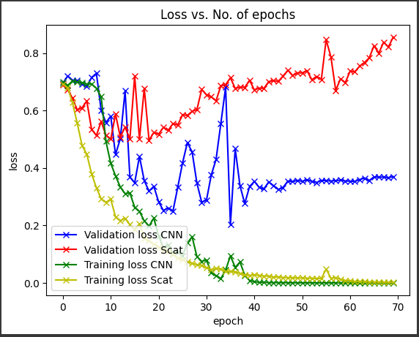
testing: CNN vs Scattering + MLP on 20% dataset
Then it has been chosen to repeat the training with only 20% of the training data and a learning rate of 0,0001
Overfitting!

Slide 13
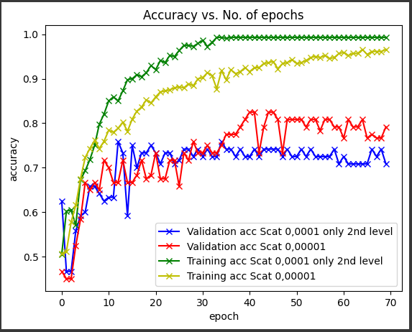
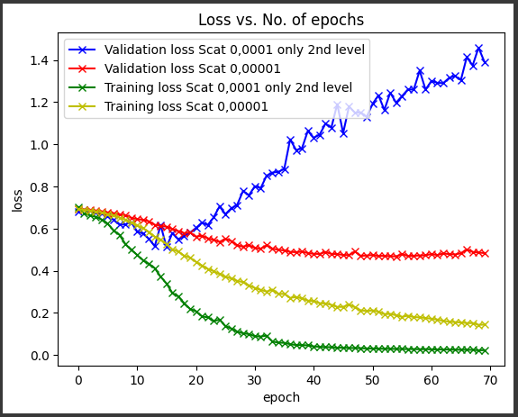
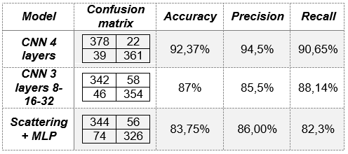
testing: CNN vs Scattering + MLP on 20% dataset
In order to eliminate this effect the model has been modified

Slide 14
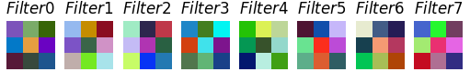
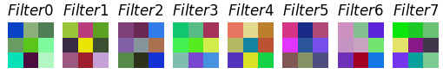
testing: visualizing CNN filters
It has been possible to color plot only the first layer because they are the only ones featuring three channels, thus being plottable as a colored image
Before training
After training

Slide 15
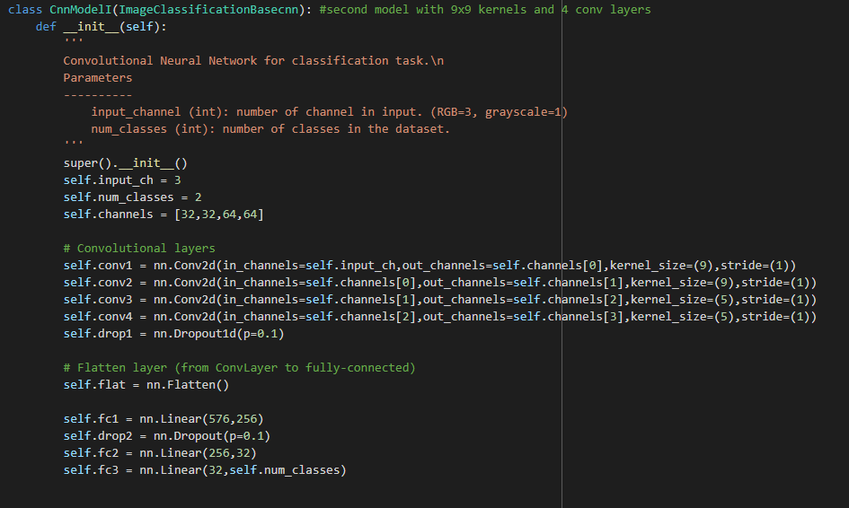
testing: visualizing CNN filters
Since from 3x3 kernels it is not possible to recongize any visual feature after the training, it has been used an other CNN model, featuring 9x9 kernels in the first two convolutional layers. This model is the one used during the lab session.

Slide 16
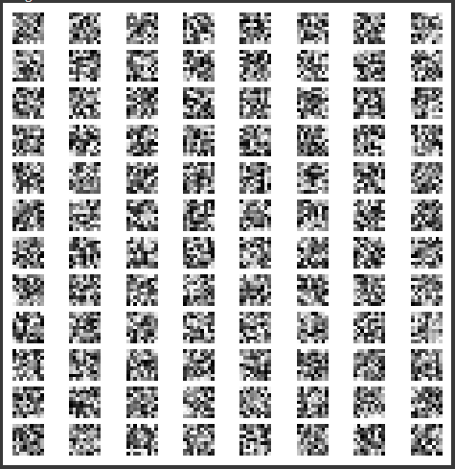
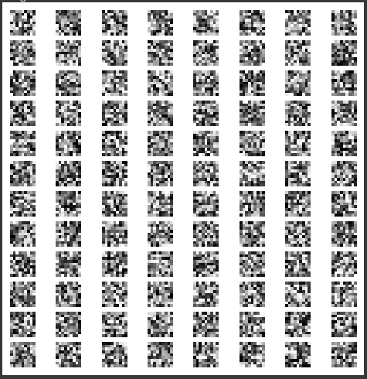
testing: visualizing CNN filters
Before training
After training
No differences!

Slide 17
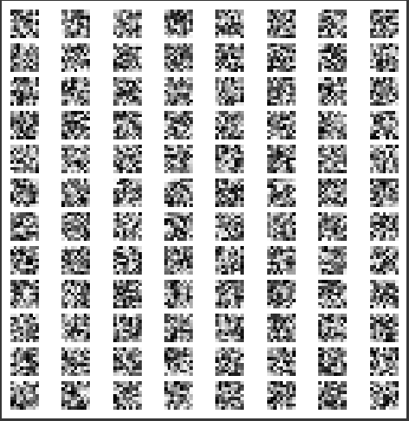
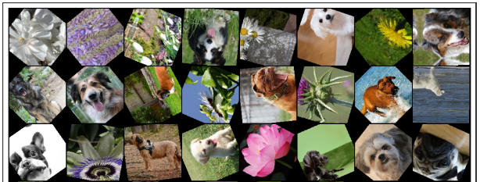
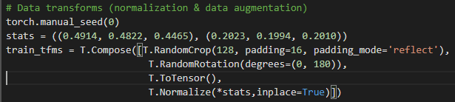
testing: visualizing CNN filters
Thus a second training has been performed on the model where images were rotated with random angles in a range 0 -180° and cropped, thus performing data augmentation.
An other attempt preforming only rotations between -45° and + 45° on the dataset images has been done without any better result even increasing the numbers of training epoch to 150. In all the above tests the validation accuracy at the end of the training was always around 92%.

Slide 18
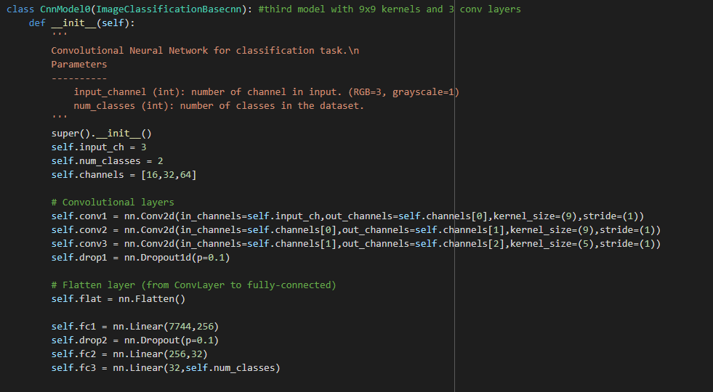
testing: visualizing CNN filters
The following experiment was then to change the model reducing the number of filters in the first layer from 32 to 16 and reducing the number of convolutional layers from 4 to 3, so 16, 32, 64 filters

Slide 19
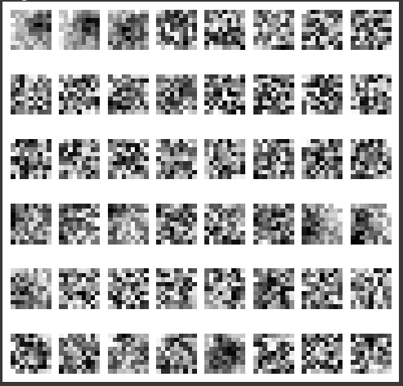
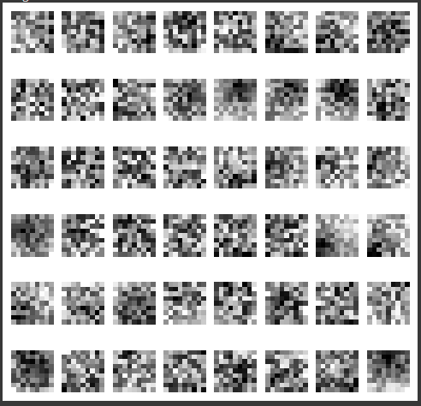
testing: visualizing CNN filters
The following experiment was then to change the model reducing the number of filters in the first layer from 32 to 16 and reducing the number of convolutional layers from 4 to 3, so 16, 32, 64 filters
Without ± 45° rotations
With ± 45° rotations

Slide 20
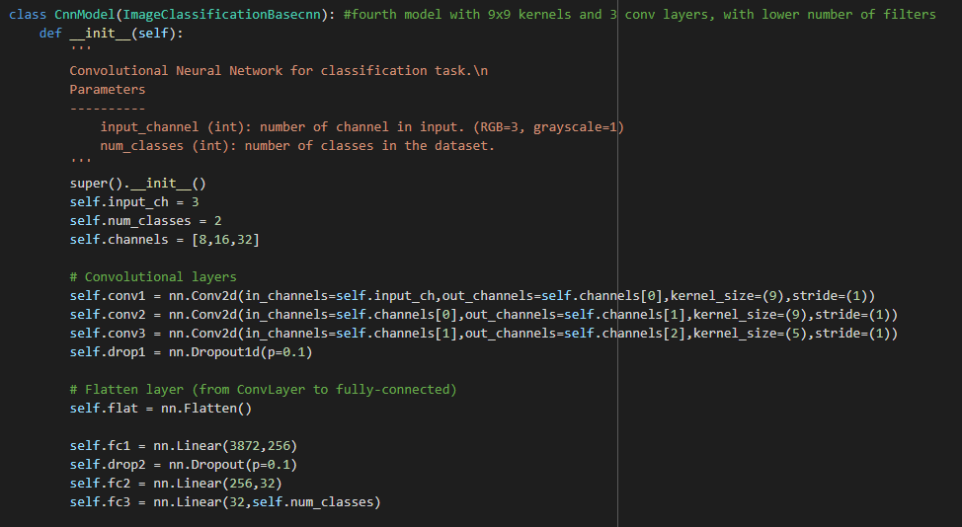
testing: visualizing CNN filters
Since there were still several filters randomly filled it has been decided to repeat the test with a model with three layers and 8, 16, 32 filters respectively.

Slide 21
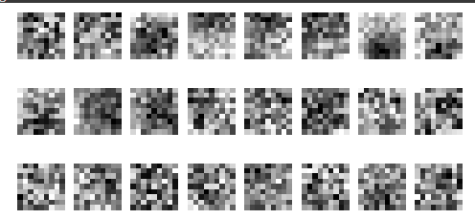
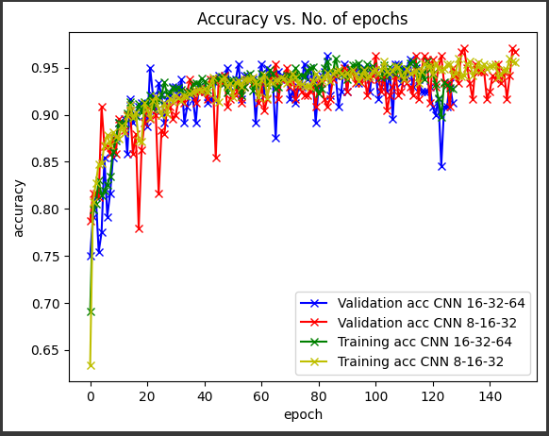
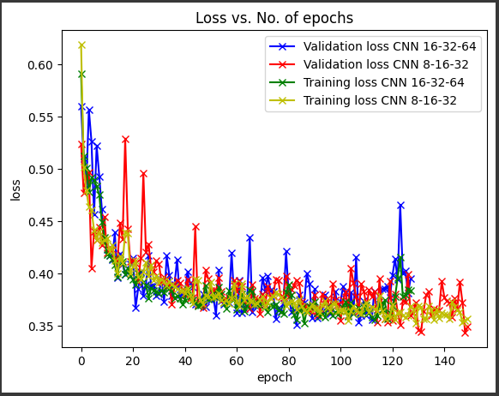
testing: visualizing CNN filters
The only better result obtained though was the accuracy, increased to 96%. To explain the observed results on different models one hypothesis could be that a too complex model can not capture well visual features from a not very wide and various dataset.

Slide 22
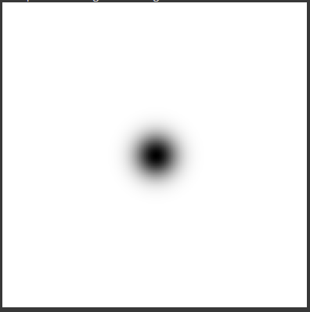
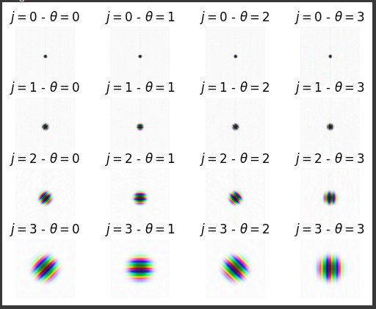
testing: visualizing scattering transform filters
Finally it has been plotted the representation of Morlet wavelet filters used to implement the scattering transform in Kymatio framework plus the scaling function

